Slide 1
E-commerce Product Pricing and Rating Analysis
Generated by Spark-Insight

Slide 2
This analysis provides insights into product pricing and customer ratings, highlighting key factors that drive customer satisfaction.
It also covers:
Recommendations
Risks and Mitigation
Opportunities

Slide 3
Discounted Price Analysis

Slide 4
Distribution of Discounted Prices
The distribution of discounted prices shows a right-skewed pattern, indicating that most products are priced lower, with a few high-value products.
Average Discounted Price: 3129.2771223513328currency — The average discounted price across all products.

Slide 5
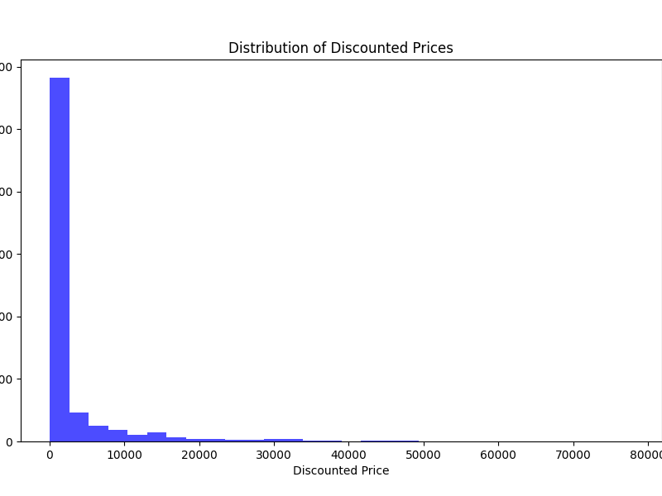
Distribution of Discounted Prices — Visualization
Histogram showing the distribution of discounted prices.

Slide 6
Rating Analysis

Slide 7
Top Ratings
The analysis of ratings reveals the top categories contributing to customer satisfaction. The 'Other' category aggregates less frequent ratings.

Slide 8
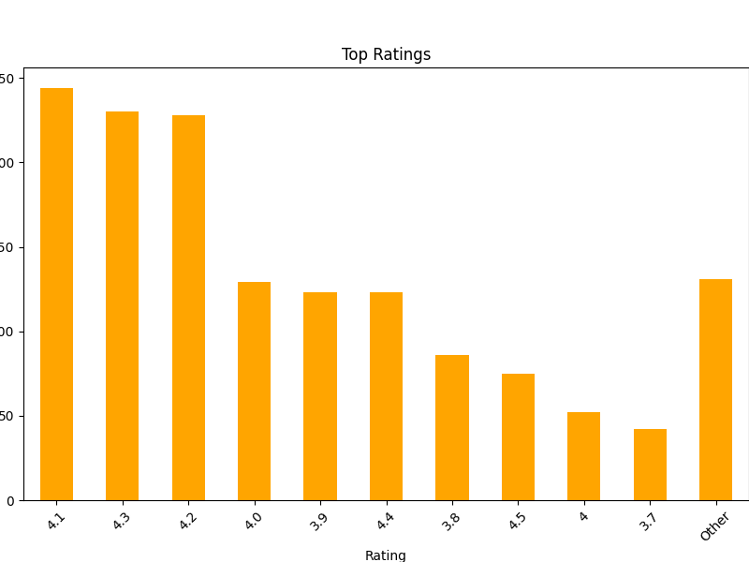
Top Ratings — Visualization
Bar chart of the top ratings.

Slide 9
Top Ratings — Table
Counts of top ratings with 'Other' aggregated.
Rating Count 4.1 244 4.3 230 4.2 228 4.0 129 3.9 123 4.4 123 3.8 86 4.5 75 4 52 3.7 42 Other 131

Slide 10
Recommendations
Focus on improving products with low ratings. Rationale: Enhancing product quality can lead to increased customer satisfaction.
Consider pricing strategies for high-value products. Rationale: Adjusting prices based on demand can optimize revenue.

Slide 11
Risks & Mitigations
Risk: High competition may impact pricing strategies. Mitigation: Regularly analyze competitor pricing.
Risk: Negative reviews can affect sales. Mitigation: Implement a feedback loop to address customer concerns.

Slide 12
Opportunities
Opportunity: Upselling to customers based on ratings. Action: Promote highly-rated products to increase sales.
Opportunity: Expanding product lines based on customer feedback. Action: Develop new products that meet customer needs.

Slide 13
Appendix
data_summary: Data shape: (1465, 16), Data types: {'product_id': dtype('O'), 'product_name': dtype('O'), 'category': dtype('O'), 'discounted_price': dtype('O'), 'actual_price': dtype('O'), 'discount_percentage': dtype('O'), 'rating': dtype('O'), 'rating_count': dtype('O'), 'about_product': dtype('O'), 'user_id': dtype('O'), 'user_name': dtype('O'), 'review_id': dtype('O'), 'review_title': dtype('O'), 'review_content': dtype('O'), 'img_link': dtype('O'), 'product_link': dtype('O')}, Missing values: {'product_id': 0, 'product_name': 0, 'category': 0, 'discounted_price': 0, 'actual_price': 0, 'discount_percentage': 0, 'rating': 0, 'rating_count': 2, 'about_product': 0, 'user_id': 0, 'user_name': 0, 'review_id': 0, 'review_title': 0, 'review_content': 0, 'img_link': 0, 'product_link': 0}
analysis_date: 2025-07-23T12:47:58.270327

Slide 14
Report Metadata
generated_at: 2025-07-23T12:47:58.270327
analyst: Spark-Insight
data_source: E-commerce Product Dataset

